Slide 1
A Case Study of Greenhouse Gases in Ontario
CSDA1000_S19_S2 Group 8
Project Participants
Fanny Guevara
Sumanpreet Kaur
Kaustubh Mulay
Notes:
In recent years, the focus on Climate change has become a top policy issue for all levels of government to aggressively develop plans to tackle emissions that contribute to climate change

Slide 2
Introduction
Two main questions:
Over time, how have the Greenhouse Gases (GHGs) in Ontario changed?
How is the change reflected within different sectors?

Slide 3
Stakeholders
Government - All levels
Organizations & Corporations
Environmental advocacy groups
Entire population of Earth
CSDA 1000 Group 8

Slide 4
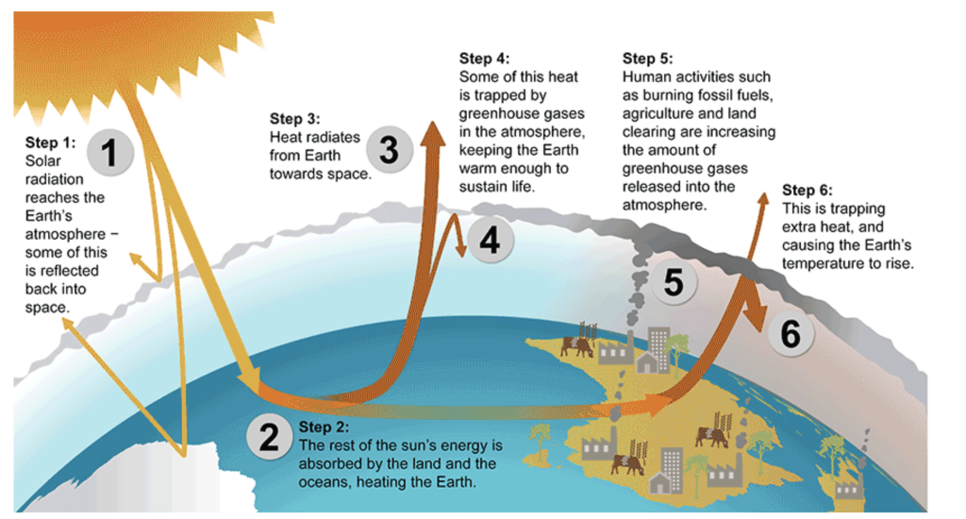

Introduction
Greenhouse Gas Effect
Greenhouse gases GHGs warm the Earth by absorbing energy and slowing the rate at which the energy escapes to space; they act like a blanket insulating the Earth.

Slide 5
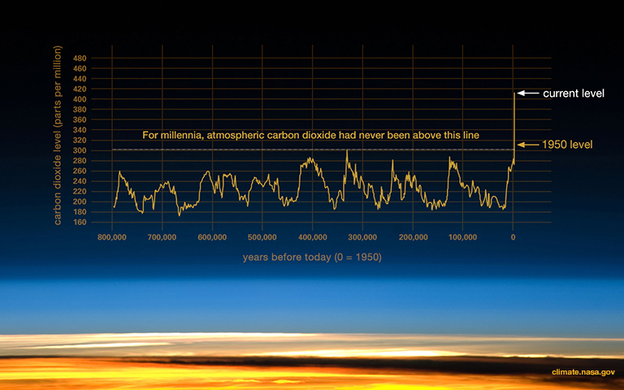
Introduction
Fact:
If you’re younger than 33, you’ve never experienced a month in which the average surface temperature of Earth was below the average of the twentieth century.

Slide 6
Climate Nasa Graph - Carbon Dioxide Levels
It is important that we note the trend in Carbon Dioxide (CO₂ ) through time has been fluctuating but has never increased more than 300 parts per million
Since the industrial revolution, there has been a sharp rise in CO₂ levels breaking previously set max level with no sign of decreasing.
Will we see a decrease in the future?

Slide 7
Data and Inventory
Our data set was retrieved from the Government of Ontario data catalogue available online
We believe this data to be accurate and reliable given the source is a government website
Data includes total annual emissions of 7 GHGs for each facility required to report to the Ministry of Energy from 2010 to 2017
Facilities that emit more than 25,000 tonnes of greenhouse gases must have their emissions verified by a third party
We believe the use of 3rd party verifiers further validates the integrity of the data

Slide 8
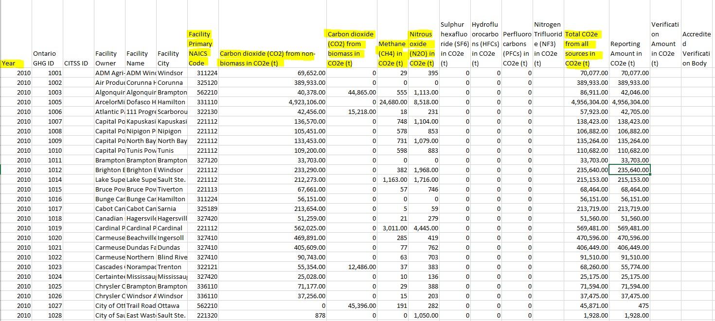
Data and Inventory
Characteristics of data:
Structured - defined labels in dataset
Near time (historical) obtained yearly
Types of variables: Both float and strings
Mean - 254,739
Min - 0
Max - 8,593,656

Slide 9
Data and Inventory
13 NAICS (North American Industry Classification System) sectors reporting to the Ministry of Energy
11 | Agriculture, Forestry, Fishing and Hunting
21 | Mining, Quarrying and Oil & Gas Extraction
22 | Utilities
31, 32, 33 | Manufacturing
48 | Transportation and Warehousing
56 | Administrative & Support, Waste Management and Remediation Services
61 | Educational Services
62 | Health Care and Social Assistance
72 | Accommodation and other Food Services
81 | Other Services (except public administration)
7 reported GHGs:
Carbon dioxide (CO₂ )
from biomass + non-biomass in CO₂e
Methane (CH₄) in CO₂e
Nitrous oxide (N₂O) in CO₂e
Sulphur hexafluoride (SF₆) in CO₂e
Hydrofluorocarbons (HFCs) in CO₂e
Perfluorocarbons (PFCs) in CO₂e
Nitrogen Trifluoride (NF₃) in CO₂e

Slide 10
Data Cleaning
Omitting irrelevant data
Specific facilities and cities: Our analysis was focused on the relationship between sectors and the GHGs being reported by facilities in Ontario. In order to investigate correlation between GHGs of specific cities and/or specific facilities additional data sets would be required.
Missing values
There are some sectors who had no facilities reporting GHGs for specific periods. Therefore, for the purpose of accuracy and completeness, the sector analysis was conducted from 2015 to 2017 which were the years that contained the most data.
No GHGs were reported for sector 49 (warehousing). Therefore, this sector has been omitted from analysis.
Creation of new variables
Data set contained highly granular sector/facility level detail. Therefore, for the purpose of our analysis, facility level detail was made less granular by converting all the subsectors to their main sectors, and the subsectors column was removed from the dataset.
Notes:
The workflow
The workflow is a sequence of three steps aiming at producing high-quality data and taking into account all the criteria we’ve talked about.
Inspection: Detect unexpected, incorrect, and inconsistent data.
Cleaning: Fix or remove the anomalies discovered.
Verifying: After cleaning, the results are inspected to verify correctness.
Reporting: A report about the changes made and the quality of the currently stored data is recorded.

Slide 11
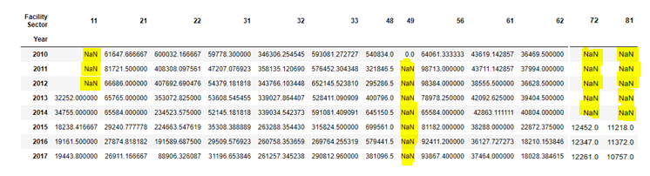
Data Cleaning

Slide 12
Hypothesis
We expected that there would be:
An increase in GHG emissions from 2010 to 2017
An increase in GHG emissions in certain sectors such as manufacturing, transportation and waste management

Slide 13
Assumptions/Limitations
Our data is limited to facilities reporting to the Ministry of Energy.
These are facilities that emit more than 10,000 tonnes of GHGs or more per year
We assumed that facilities that do not report their GHG emissions to the ministry, have the same composition of GHGs as the facilities that do report to the ministry.
The sector analysis was computed using 2014 - 2017 figures as the data for certain sectors was not available during the period of 2010 - 2013.
Our data set excludes GHG emissions from vehicles and would not be counted in the Transportation and Warehousing sector totals.

Slide 14
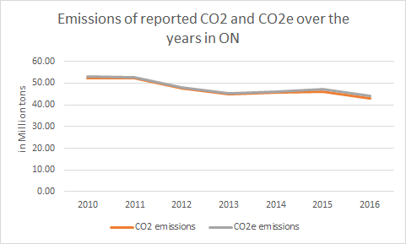
Data Analysis
The total change in emissions of CO₂ e v/s time and also the total change in emissions in CO₂ was plotted to find the need to target the emissions of the other gases as well. The resultant graph showed that it would be reasonable to target only CO₂ and not the other gases.
For this, new variables Total CO₂ and Total CO₂ e were created.
Notes:
Hypothesis: An increase in GHG emissions from 2010 to 2017

Slide 15
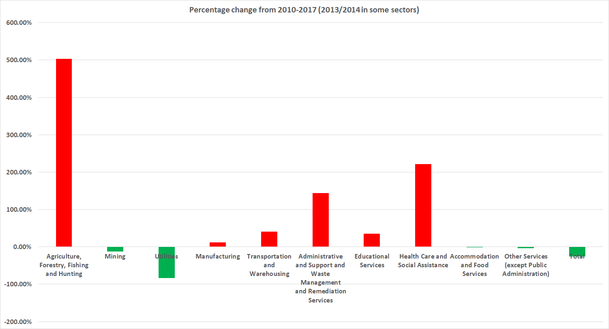
The percentage change in emissions for all sectors during the reported years was plotted in order to understand what occured in each sector. It was identified that Agriculture, Forestry, Fishing and Hunting were the sectors with the biggest change. However, the total contribution of this sector is not significant in comparison to other sectors with higher emissions.

Slide 16
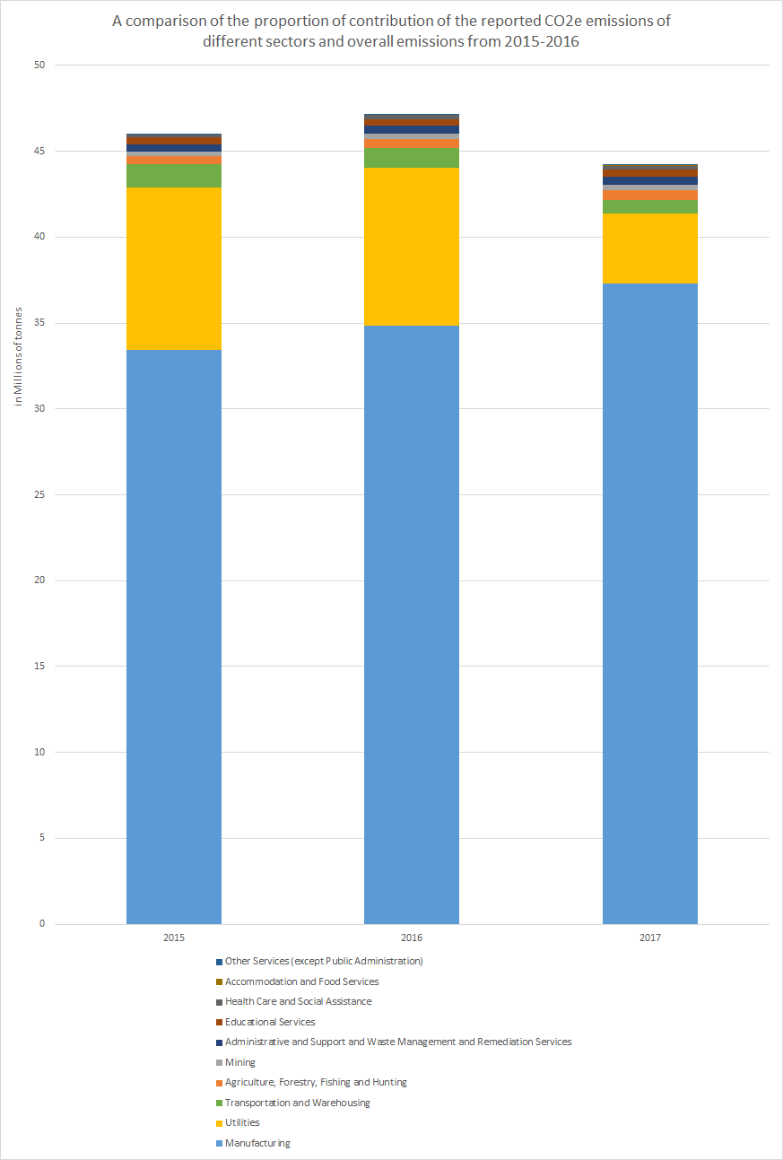
Data Analysis
Findings:
The Manufacturing sector is the sector with the largest amount of CO₂ being reported and whose emissions have been increased year-over-year.
In contrast, the emissions in the Utilities sector had a significant decrease starting in 2014. It could be said that Manufacturing & Time have a positive correlation coefficient whereas Utilities & Time have a negative correlation coefficient.
We would recommend regression testing with additional data sets for future analysis to understand what lead to the increase in emissions in manufacturing and a stark decrease in Utilities.

Slide 17
Conclusion
There are multiple lines of evidence that show the climate system is changing.
Increase in the mean global temperature
Melting ice caps & glaciers
While the data showed an overall decrease in GHG emissions in Ontario during the observed period, the sector based analysis yielded the most value.
Initial findings point towards the need for sector based climate change policies.
Hypothesis Recap:
An increase in GHG emissions from 2010 to 2017
Our analysis showed that there was an overall decrease in CO₂ emissions reported by facilities
An increase in GHG emissions in certain sectors such as manufacturing, transportation and waste management✅
Our analysis supported our hypothesis that there was an increase in reported emissions in the expected sectors

Slide 18
Future Considerations
The objective of this case study was to understand GHGs being reported by facilities in Ontario.
Future studies would focus on understanding initiatives undertaken in the Utilities sector to be able able to replicate activities that would be most impactful in reducing GHGs for other sectors.
We know from our research that the reduction in GHGs seen in 2014 were largely due to the phase out of coal generation. Thus, we must focus future research on finding initiatives with equivalent impact in other sectors such as Manufacturing that will yield the significant reduction
Further, municipalities could also frame policies or provide incentives to organizations/industries in specific cities in order to reduce GHGs

Slide 19
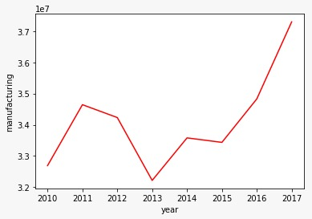
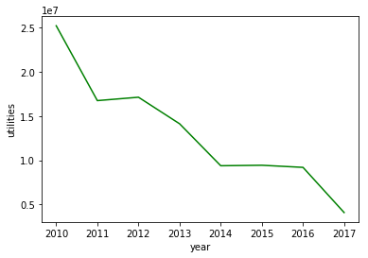
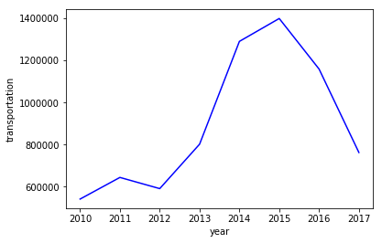
Appendix
Total CO₂ e in Tons for Manufacturing sector from 2010-2017
Total CO₂ e in Tons for Utilities sector from 2010-2017
Total CO₂ e in Tons for Transportation sector from 2010-2017

Slide 20
Appendix (cont’d.)
The figures in the previous slide show the total CO₂ emissions for the top three sectors that contribute to GHG emissions being reported by facilities in Ontario from 2010 to 2017.
Manufacturing sector: The graph shows an upward trend in GHG emissions throughout the reported years. This points to the need for initiatives in this sector to reduce the GHG emissions.
Utilities sector: This sector shows a decrease in GHG emissions over the reported time. It is worthwhile to look into what caused this downward trend. We know, from our research, that it was mostly due to the phase-out of the coal plants in 2014. However, more research and analysis is needed to determine what caused the continuation of the downward trend.
Transportation sector: This sector shows an upward trend until 2015 and then downward in the last two reported years. It is important to note that vehicular emissions are not reported in the facilities data. However, there is still a need for further analysis as to what caused the decrease from the sharp increase in the previous years.

Slide 21
Appendix (cont’d.)
Overall, our research and analysis shows that there is a need for sector-based climate change initiatives. However, more research and analysis is required to assess what kind of initiatives are required to decrease the levels of GHG emissions in the sectors with the increasing GHG emissions. The good news is that there are some sectors whose GHG emissions have been decreasing over time (as shows by the graphs in previous slide). There is an opportunity to learn from these sectors and apply the same creative and innovation in an effort to decrease the GHG emissions in the future years to come.

Slide 22
Bibliography
World Meteorological Organization. (2017). ​An Integrated Global Greenhouse Gas Information System (IG3IS).​ Author. Retrieved from https://public.wmo.int/en/resources/bulletin/integrated-global-greenhouse-gas-informati on-system-ig3is
Environmental Commissioner of Ontario. (2018). ​Climate Action in Ontario: What’s Next? 2018 Greenhouse Gas Progress Report​. Retrieved from https://docs.assets.eco.on.ca/reports/climate-change/2018/Climate-Action-in-Ontario.pdf
Government of Ontario Data Catalogue. (April 15, 2019). ​Greenhouse Gas Emissions Reporting by Facility​. Retrieved from https://www.ontario.ca/data/greenhouse-gas-emissions-reporting-facility
Global greenhouse gas emissions. Retrieved from https://www.canada.ca/en/environment-climate-change/services/environmental-indicato rs/global-greenhouse-gas-emissions.html
Global Warming Potentials. Retrieved from https://www.epa.gov/ghgemissions/understanding-global-warming-potentials
NAICS codes. Retrieved from https://www.naics.com/
Corporate Finance Institute. ​Correlation - Overview, Formula and Practical Example.​Retrieved from https://corporatefinanceinstitute.com/resources/knowledge/finance/correlation/
IBM Knowledge Centre. (2012). ​CRISP-DM Help Overview. R​ etrieved from https://www.ibm.com/support/knowledgecenter/en/SS3RA7_15.0.0/com.ibm.spss.crispd m.help/crisp_overview.htm
Government of Canada. (2017). ​Greenhouse gas emissions: drivers and impacts.​ Author. Retrieved from https://www.canada.ca/en/environment-climate-change/services/environmental-indicators/greenhouse-gas-emissions-drivers-impacts.html
Government of Canada, National Energy Board. (2019). ​Provincial and Territorial Energy Profiles – Ontario.​ Author. Retrieved from https://www.neb-one.gc.ca/nrg/ntgrtd/mrkt/nrgsstmprfls/on-eng.html
EarthMatters - Carbon Dioxide Reaches Record Levels, Plus 6 Things to Know About the Greenhouse Gas. Retrieved from https://earthobservatory.nasa.gov/blogs/earthmatters/2019/06/14/carbon-dioxide-reaches-record-levels-plus-6-things-to-know-about-the-greenhouse-gas/

Slide 23
Thank you!

